Slide 1

TEACH FOR AMERICA -WHARTON PEOPLE ANALYTICS CHALLENGE
Executive Summary
Team: GoHuskies915

Slide 2
Executive Summary
Optimal resourcing strategy can be achieved by grouping universities based on amount of recruitment effort, type of recruitment effort and quality of institution
Based on above parameters, it was identified that the 2017 tiers were not homogenous
Using unsupervised machine learning technique (k-means clustering) it was identified that 4 distinct tiers should be formed
Tier 1 consists of outperforming universities with very high accepted candidates per college and highest selectivity
There are only 5% universities in this tier but they contribute to 30% of accepted candidates
These universities should be primary focus of the recruiters
Tier 2 colleges (15% of the colleges) account for 34% of the accepted candidates (highest amongst all the tiers). So Tier 2 universities deserves same amount of focus as Tier 1 but can that be achieved by employing a lesser number of recruiters per university
With 192 universities, Tier 3 is the largest cluster. But average number of applications and awareness for these universities is very low. So recruiters should focus on improving awareness in these universities
Worst performing universities have been grouped in Tier 4. Most of the colleges if this Tier were not even part of recruitment strategy for 2017. With only 8% of the accepted candidates, these should be lowest on the priority list of the recruiters

Slide 3
Problem Statement

Slide 4


TFA wants to improve its recruitment strategy by optimizing the University Tiers
Gaps
Lack of analytical framework
Current State
Future Desired State
The new tiering framework
Recruitment Effort
Effort Type
Quality of Institute
Optimum tiers identified
2 and 3 tiers for 2016 & 2017 respectively
TFA wants to know:
Number of tiers
University tier mapping
Key Questions
What are the key variables?
How to cluster universities together?
Notes:
Teach For America differentiates resource allocation for recruitment at campuses, based on the competitive dynamics
There were 2 and 3 tiers respectively in 2016 and 2017
TFA wants to improve its recruiting strategy by understanding what is the optimum number of tiers and which school should be in which tier
Lack of framework to understand and quantify the recruitment effort required in each campus
What are the variables that can be used to capture in recruiting from a campus?
How to group campuses such that campuses requiring similar effort and have similar quality can be grouped together?
Teach For America has a framework to understand the recruitment effort required in each college
Teach for America has optimum number of tiers and has campuses classified in each tiers based on recruitment effort, type of recruitment effort and quality of the institution

Slide 5
Methodology

Slide 6
We have taken a 4 step approach to identify the optimal number of tiers
Step 4
Variable Selection
Evaluate Current Tiers
Create New Tiers
Step 3
Profiling of the tiers
Provide recommendations
Step 2
Design a framework to create new tiers which can solve the problems identified in Step 2
Step 1
Based on the variables identified in step 1, understand the possible issues with the current tiers
Results And Insights
Identify the variables which can be used to gauge quality of an institution and the type and amount of the recruitment effort

Slide 7
Variable Identification

Slide 8

We have identified the variables that can be used to gauge recruitment effort and quality of the institution
# Candidates
Met
Awareness Level
Meet candidates
on Campus
Sourcing candidates
Create awareness on Campus
# Sourced by RT
How good is the university?
Going through the application and Processing them
# Accepted
Selectivity
# Applications
TFA Recruiter

Slide 9
Evaluating Current Tiers

Slide 10
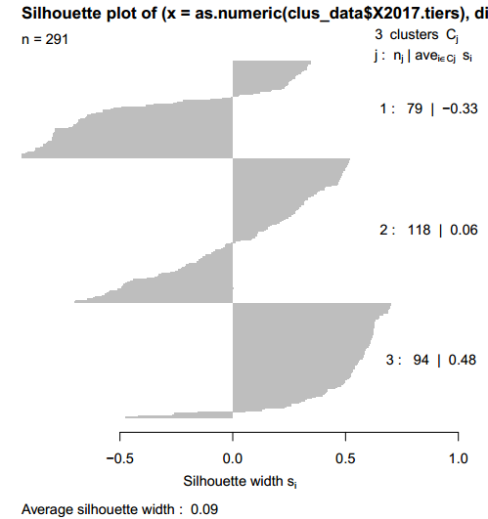
The current tiers are not homogenous and there is a scope of creating better groups
Silhouette Plot of 2017 Tiers
We created the Silhouette Plot to understand the consistency of 2017 Tiers
The silhouette value is a measure of how similar an object is to its own cluster (cohesion) compared to other clusters (separation)
The silhouette ranges from -1 to 1, where a high value indicates that the object is well matched to its own cluster and poorly matched to neighboring clusters
Variables used - #Applications, #Student Met, Selectivity, #SourcedByRT, #Withdrawn
2
Observations and Insights
The overall silhouette value for ‘2017 Tiers’ is 0.09. This indicates that the there is lack of consistency within the Tiers
Silhouette value for Tier1 is -0.33. This indicates very poor grouping of universities in this Tier
The campuses can be grouped to create more homogenous cluster based on variables that determine recruitment effort and quality of the institutions
1
2
1

Slide 11
Creating New Tiers

Slide 12
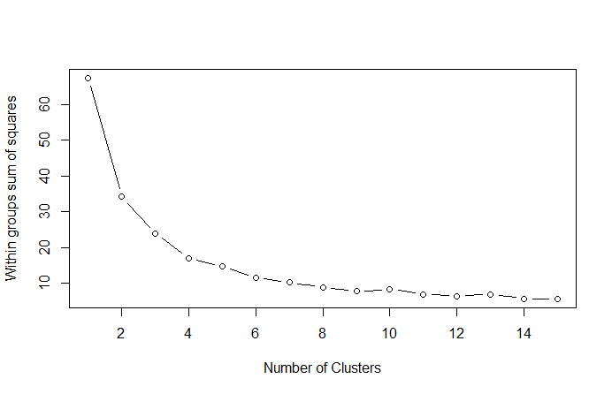
We used unsupervised machine learning to group campuses based on recruitment effort and quality of the institution
Unsupervised Machine Learning Approach
Determining number of Tiers
Campus base
*Campus base = 290 campuses + 150 campuses
Resourcing Effort = f (# Applications, #Candidates Met, #SourcedByRT, #Accepted, Awareness Level)
Quality of the institution = f (Selectivity)
Clustering
6 variables were used for clustering
K-means clustering approach was used
4 clusters were produced
Data preparation
The elbow curve suggests that optimum number of grouping in this case is 4
If the profiling results would suggest that 4 clusters are homogenous then we would proceed with 4 clusters

Slide 13
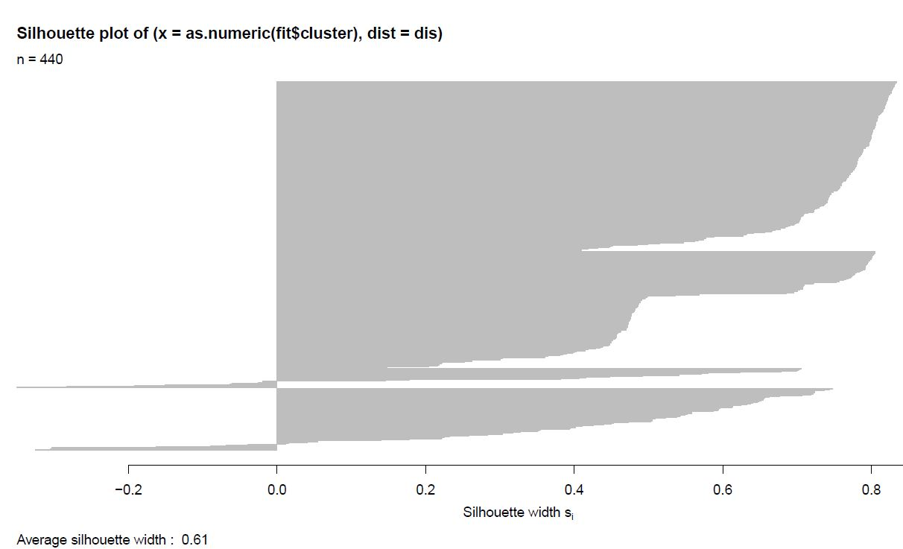
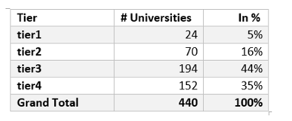
The new clusters are much more homogenous compared to older Tiers
Silhouette Plot of New Tiers
Observations and Insights
The overall silhouette value for our new cluster is 0.61. This indicates that the new clusters are much more homogenous
This is also visible from the fact that the graph is now mostly concentrated on the right side of the Y axis.
Following is the high level view of the new tiers
1
2
Tier 3
Tier 4
Tier 1
Tier 2
1

Slide 14
The new groups do a better job in grouping campuses based on campus quality and recruiting effort
Profiling based on clustering variables
Defining the Clusters
24
70
192
152
University Count
These are the top performing universities and should be #1 on priority list of the TFA recruiters
There are 70 Universities in this category. These are slightly less attractive than Outperformers but quite better than tier 3 (Probables)
Tier 1
Tier 2
Tier 3
Tier 4
¹Avg. # Applications | 121 | 56 | 18 | 13
Avg. # Alumni | 505 | 220 | 65 | 14
Avg. # Accepted | 35 | 14 | 4 | 1
Avg. # Withdrawn | 27 | 12 | 4 | 2
Avg. # Met | 67 | 31 | 10 | 4
Avg. # Sourced byRT | 54 | 24 | 7 | 3
²Selectivity | 4.5 | 4.2 | 4.1 | 2.7
Tier 1
Outperformers
Tier 2
Challengers
Selectivity of these universities is on par with Tier 1 and Tier 2, but it performs poorly across rest all the variables
Campuses of this tier have very low selectivity. Also, most 70% of these colleges were not included in 2017 recruitment
Means of all the clusters across the variables are widely apart
This indicates that in the new clusters, campuses have been grouped more homogeneously based on the basis of campus quality and recruitment efforts
Tier 3
Probables
Tier 4
Laggards
1Avg. # Application = Total # Applications in the Tier / # Universities in the Tier
2Selectivity (derived field) is on a scale of 1-5, where 5 being most selective

Slide 15
INSIGHTS & RECCOMENDATIONS

Slide 16



Tier 1 is the most promising clusters and should be primary focus of the recruiters
Tier 1 – Outperformers (24 universities)
Contribution
This tier comprises of only 5% of the universities but they account for 30% of the all the accepted applications
5%
Average accepted per college
Average # Accepted candidates per university for these campuses is more than twice compared to Tier 2 and five times compared to overall average
Tiers
# Universities
24%
More than half (51%) of the applicants from these universities have been offered an offer
% Public university
# Applications
In this Tier 17 (70%) out of 24 are public universities, while on an average only 40% of the universities are public
30%
Overall
Amount of Effort
Effort Type
Campus Quality
# Accepted
Managing
Applications
Elite
Selectivity
High
4.5
2.3
These universities outperform all the other tiers and should be primary focus of the recruiters
*Awareness
*Awareness (derived field) is on a scale of 1-3, where 3 being most aware
Notes:
By focusing on just these 5% of the universities, the recruiters can cater to more than a quarter of applicants and accepted candidates
These universities have highest acceptance rate (29%) amongst all the tiers

Slide 17



Tier 2 Universities deserve same amount of focus as Tier1 but recruiter’s focus areas should be different
Tier 2 – Challengers (70 universities)
Contribution
34% (highest) of all the accepted candidates come from these 70 (16%) universities
16%
Application per college
Average number of applications per college from Tier 2 colleges is half compared to Tier 1 colleges
# Universities
Tiers
32%
So, these colleges need lesser number of recruiters per college compared to Tier 1
Compared to Tier 1, a lesser percentage of candidates are sourced by Recruiters
# Applications
34%
Awareness level is lower compared to Tier 1
Amount of Effort
Effort Type
Campus Quality
# Accepted
Sourcing +
Awareness
Good
Selectivity
High
4.2
2.0
Sourcing more candidates would improve the acceptance rate and improving awareness would increase number of applications
Awareness
Notes:
For point 4 talk about acceptance rate of Sourced by RT being higher than self Sign up

Slide 18



Recruiters should focus primarily on improving awareness in Tier 3 Universities
Tier 3 – Probables (192 universities)
Contribution
With 192 (43%) universities, this tier have most number of universities. 28% of the applications and 28% of the accepted candidates come from this tier
43%
Application per college
Average number of applications per college from Tier 3 colleges is only one third compared to Tier 1 colleges
# Universities
Tiers
28%
*Acceptance rate for these universities and Selectivity of these colleges is almost same as Tier 2 universities
Awareness Level
# Applications
Awareness level in these colleges is significantly lower compared to Tier 2 and Tier 1 colleges
28%
Tiers
Amount of Effort
Effort Type
Campus Quality
# Accepted
Awareness
Good
Selectivity
Low
4.1
1.6
Recruiters should focus on improving awareness in these universities
Awareness
* Acceptance Rate = Total number of acceptances/Total number of Applications
Notes:
Need acceptance rate chart
Point 3 suggests that these are also quality institutions, so if recruiters can increase number of applications from these universities, some these universities might move to upper Tiers
So to increase number of applications from these universities, recruiters should focus on improving awareness

Slide 19



Recruiters should focus on improving awareness in Tier 3 Universities
Tier 4 – Laggards (152 universities)
Contribution
Worst performing universities have been grouped in Tier 4. But with 152 (35%) universities, this tier has substantial number of universities
35%
Only 16% of the applications and 8% of the accepted candidates come from this tier
# Universities
16%
120 (80%) Universities in this tier are those which have not been considered as per 2017 categorization.
# Applications
8%
Amount of Effort
Effort Type
Campus Quality
# Accepted
Multiple
Avg.
Lowest
Selectivity
2.7
Acceptance rate for these Universities, # Alumni and Selectivity of these colleges is extremely low hence these should be of lowest priority.
1.6
Awareness

Slide 20
SUMMARY

Slide 21
Executive Summary
Optimal resourcing strategy can be achieved by grouping universities based on amount of recruitment effort, type of recruitment effort and quality of institution
Based on above parameters, it was identified that the 2017 tiers were not homogenous
Using unsupervised machine learning technique (k-means clustering) it was identified that 4 distinct tiers should be formed
Tier 1 consists of outperforming universities with very high accepted candidates per college and highest selectivity
There are only 5% universities in this tier but they contribute to 30% of accepted candidates
These universities should be primary focus of the recruiters
Tier 2 colleges (15% of the colleges) account for 34% of the accepted candidates (highest amongst all the tiers). So Tier 2 universities deserves same amount of focus as Tier 1 but can that be achieved by employing a lesser number of recruiters per university
With 192 universities, Tier 3 is the largest cluster. But average number of applications and awareness for these universities is very low. So recruiters should focus on improving awareness in these universities
Worst performing universities have been grouped in Tier 4. Most of the colleges if this Tier were not even part of recruitment strategy for 2017. With only 8% of the accepted candidates, these should be lowest on the priority list of the recruiters

Slide 22
THANK YOU
Executive Summary
GoHuskies915

Slide 23
Executive Summary
Q & A

Slide 24
Executive Summary
APPENDIX

Slide 25
Insights
Candidates Sourced
Multiple Majors
Candiates Sourced | ACCEPTED | REJECTED
Self Sign Ups | 26% | 74%
Sourced by RT | 36% | 64%
Grand Total | 30% | 70%
Significantly higher acceptance rates are observed for candidates sourced by RT and Candidates with multiple majors
Multiple Majors | ACCEPTED | REJECTED
No | 29% | 71%
Yes | 38% | 62%
Grand Total | 30% | 70%
Public vs Private - # Applications
Public vs Private - # Alumni
Public vs Private - # Curr Alumni
Univ Type | # Applications (Avg)
Private | 21
Public | 42
Grand Total | 31
Univ Type | # Alumni (Avg)
Private | 107
Public | 111
Grand Total | 109
Univ Type | # Current Alumini (Avg)
Private | 15
Public | 23
Grand Total | 19
Average no of applications from Public universities are almost double as compared to private ones
We observe a higher attrition among recruits from Private universities as even though historically, the average no of alumni from public and private universities are the same, currently, more people from Public universities are associated with TFA
 | Awareness Levels
Selectivity level | 1 | 2 | 3
0 | 36 | 49 | 49
1 | 28 | 50 | 61
In universities with higher selectivity, awareness plays an important role in driving the no of applications. TFA should create awareness in more/most selective universities (selectivity level =1). This would increase the no of applications significantly

Slide 26
Tiers: Distribution

Slide 27
Exploratory analysis supports the observations of Silhouette plot that there is mix bag of colleges in 2017 Tiers
Variance Comparison – Variance of Overall Data vs. Combined Variance of Tiers
Tiers | Variance
 | #Applications | #Alumni | #Accepted | #Withdrawn | #Candidates Met | #SourcedbyRT
All 2017 | 1178 | 23936 | 102 | 59 | 355 | 240
Tier 1 | 2266 | 43031 | 204 | 114 | 652 | 447
Tier 2 | 513 | 5565 | 22 | 18 | 105 | 105
Tier 3 | 150 | 767 | 4 | 5 | 25 | 21
*Difference in Variance | -1751 | -25427 | -128 | -77 | -427 | -332
*Difference in Variance = Variance of “All 2017” – SUM (Variance of Tier1, Tier2, Tier3)
Across al the variables the combined variance of the three 2017 Tiers is more than the overall variance of data. This indicates that the highly dissimilar universities have been grouped together
Additional Observation - We also observed that 21% of the universities of Tier1 have values lower than the mean values of Tier 2 across all the variables
So all of these observations suggest that there is ample scope of refining the tiers so that similar campuses can be grouped together for more effective recruitment strategy

